Slide 1
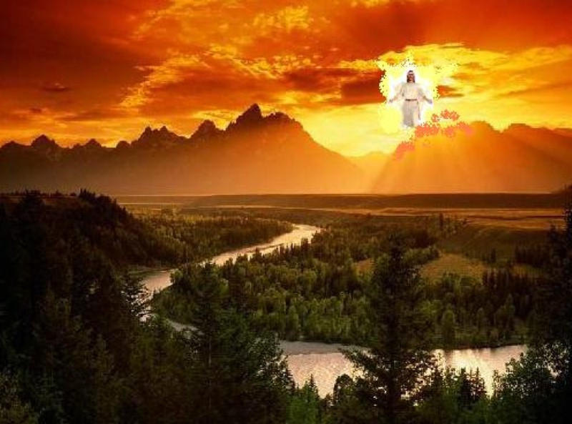
Other Events at the Rapture
Dr. Rick Griffith • Jordan Evangelical Theological Seminary • BibleStudyDownloads.org

Slide 2
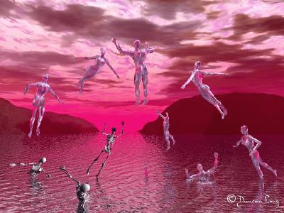
The Rapture

Slide 3
Resurrections & Judgments
160
R = 4 Resurrected Groups
J = 7 Judged Groups
Rapture
2nd Advent
R
2R
R
Great
White
Throne
J
4J
2J
Church Age
Tribulation
Millennium
Battle of
Armageddon
Battle of
Gog and Magog

Slide 4

Judgment Seat of Christ
160
Believers Rewarded by Christ (2 Cor. 5:10)
At the Rapture
(1 Thess. 4:17)
Reward or loss of rewards (not salvation)

Slide 5

"In a moment we will be changed"
1 Cor. 15:51-52

Slide 6
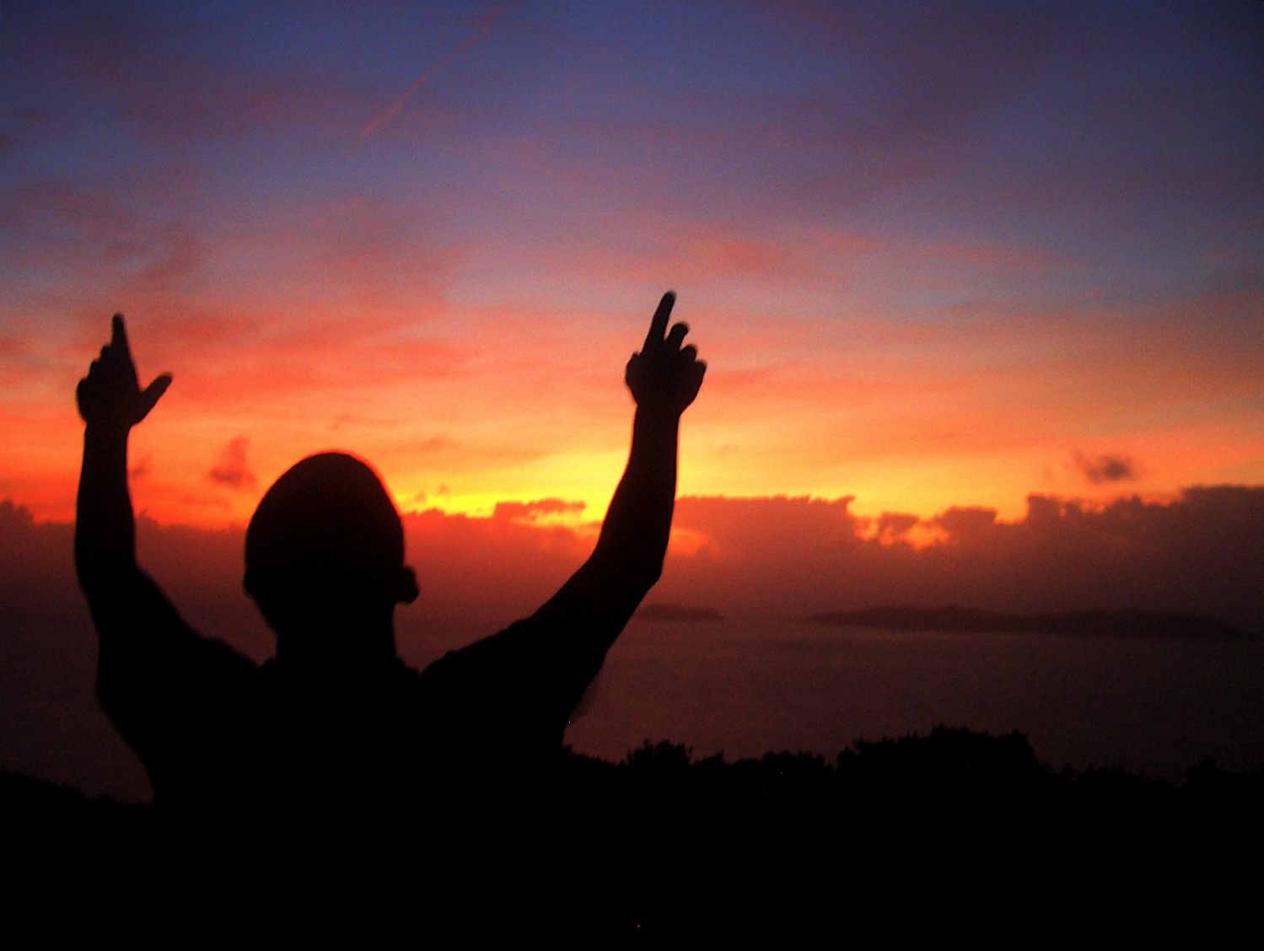
Three Illustrations of Our New Bodies:
• Plant Life (15:36-38)
• Animal Life (15:39)
• Inanimate Objects (15:40-41)

Slide 7
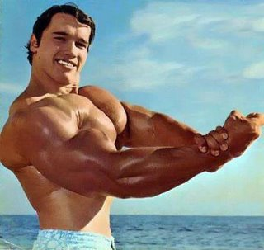
The Resurrected Body

Slide 8

We will join him in the clouds
(1 Thess. 4:16)

Slide 9
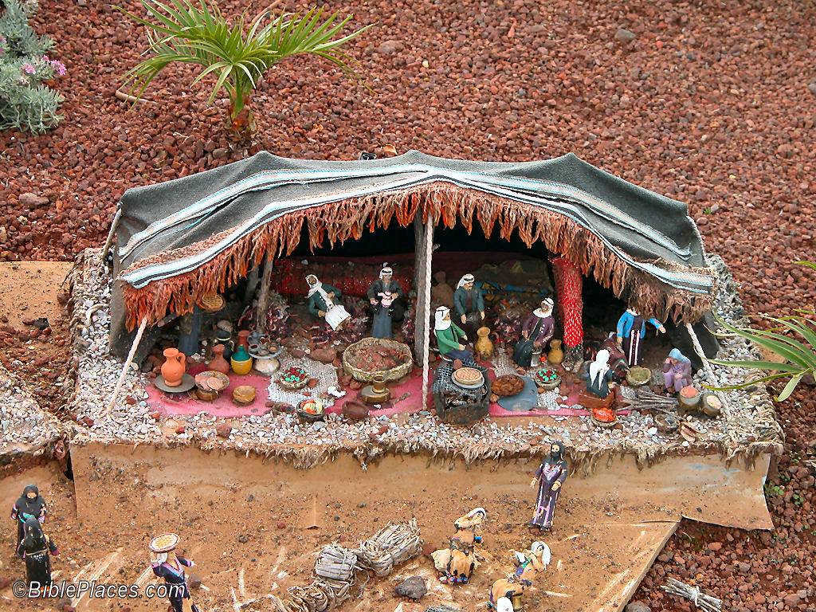
We will put away "this present tent"
(2 Cor. 5:1)

Slide 10
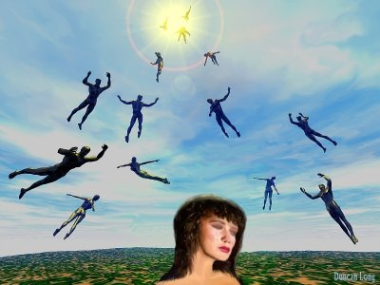
New bodies

Slide 11
The Judgment Seat of Christ
Is this a judgment to determine salvation?
Or is it to reward believers?

Slide 12
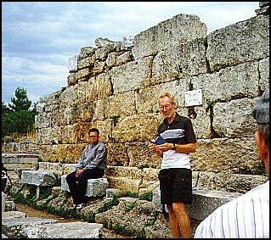
The Bema Still Exists
Notes:
12

Slide 13
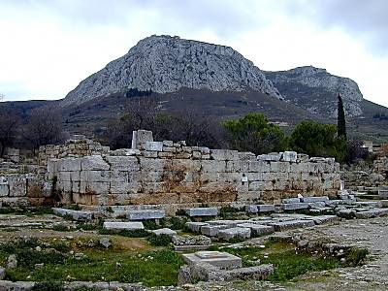
Bema with Acrocorinth in Distance
Notes:
13

Slide 14
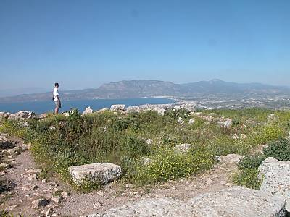
View from Acrocorinth
Notes:
14

Slide 15
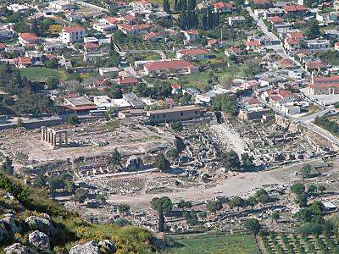
The Main City Below
Notes:
15

Slide 16
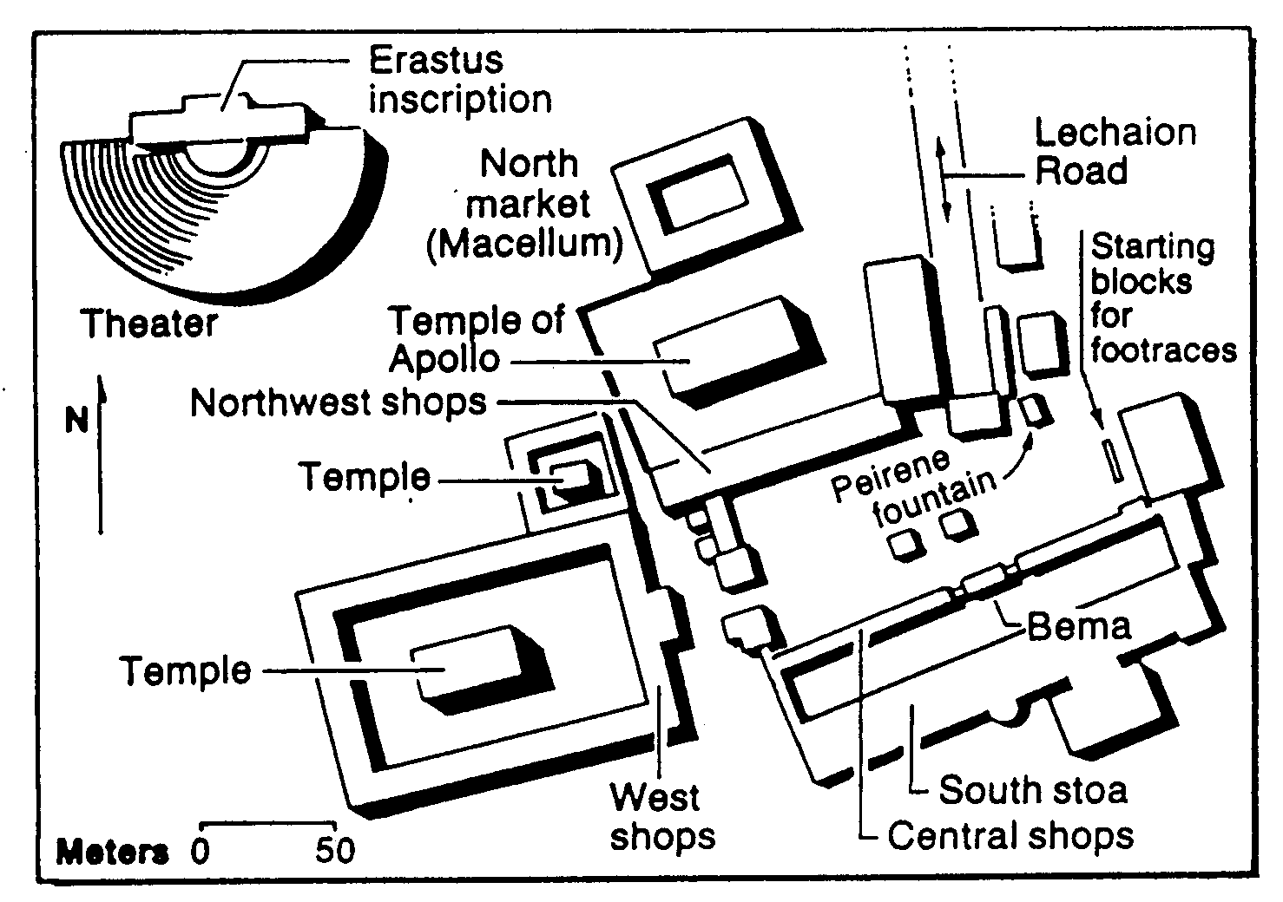
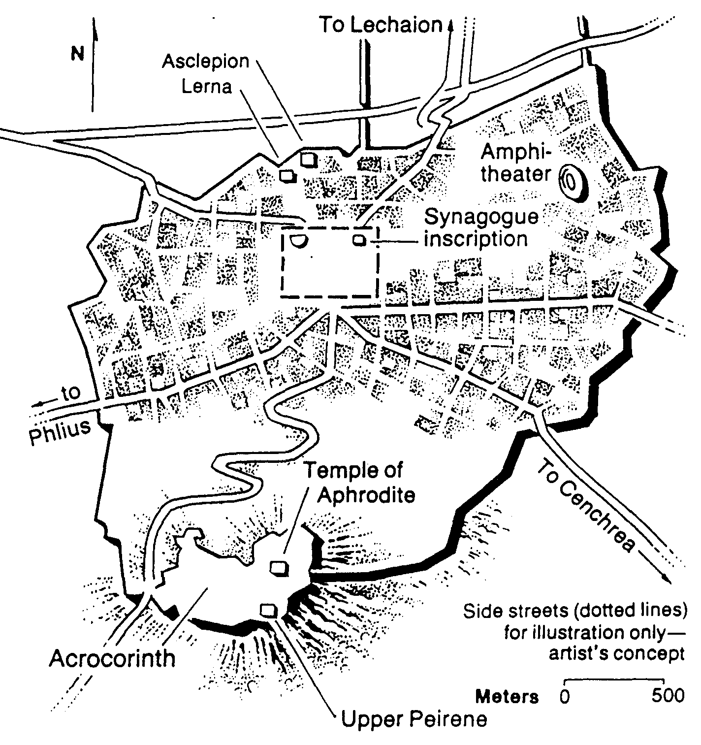
The Corinthian Marketplace
Bible Visual Resource Book, 235

Slide 17
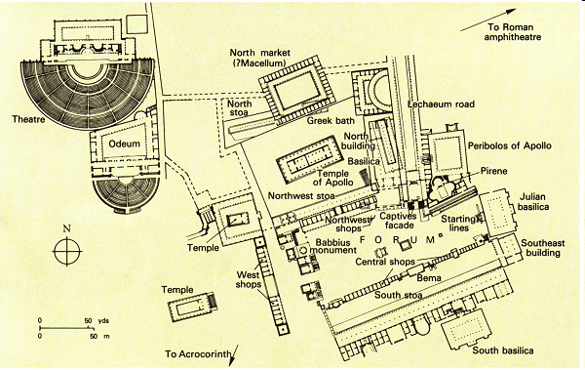
The Bema at Corinth
"But while Gallio was proconsul of Achaia, the Jews with one accord rose up against Paul and brought him before the judgment seat [bema]" (Acts 18:12)
Lawsuits
1 Cor. 6
Bema
Paul brought before judgment seat
Acts 18:12

Slide 18
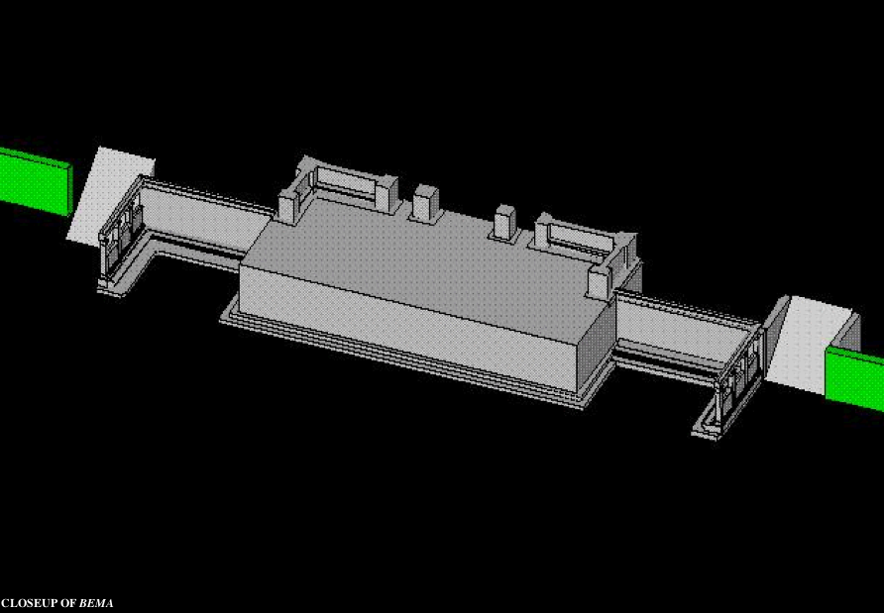
Bema Close-up
“So we make it our goal to please him, whether we are at home in the body or away from it. ¹⁰For we must all appear before the judgment seat [bema] of Christ, that each one may receive what is due him for the things done while in the body, whether good or bad” (2 Cor. 5:9-10 NIV).
Notes:
18
http://corinth.sas.upenn.edu/schola.html

Slide 19
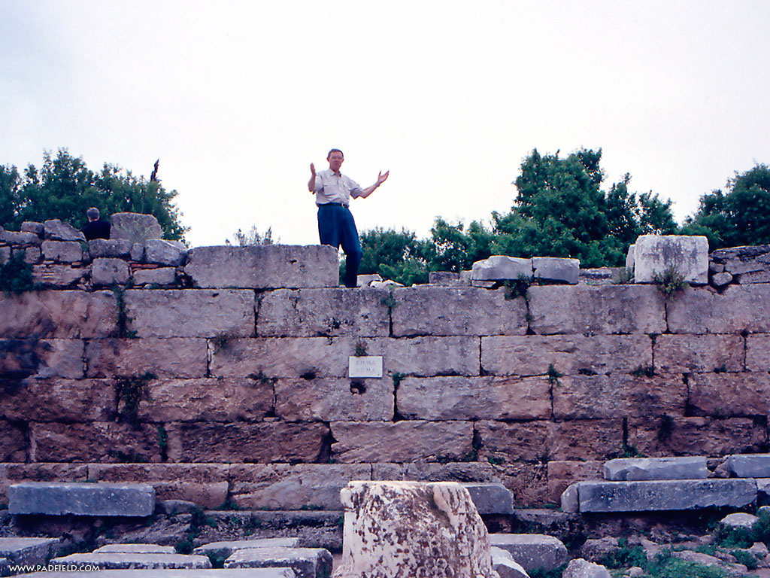
The Speaker or Judge Above
The Speaker or Judge Above
Notes:
19

Slide 20
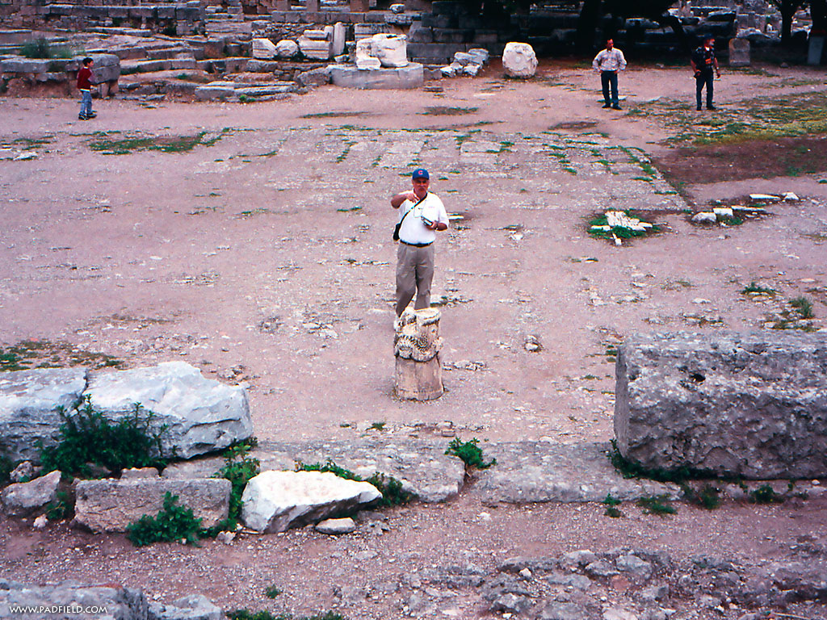
The One Being Judged or Rewarded Stood Below
Notes:
20

Slide 21
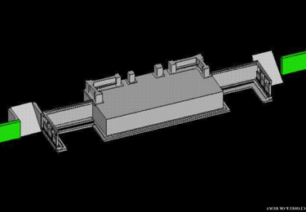
Bema for Rewards
75
"In Grecian games in Athens, the old arena contained a raised platform on which the president or umpire of the arena sat. From here he rewarded all the contestants; and here he rewarded all winners. It was called the 'bema' or 'reward seat.' It was never used of a judicial bench."
L. Sale-Harrison, Judgment Seat of Christ, 8
cited by Pentecost, Things to Come, 220
Really?
Notes:
21
21

Slide 22
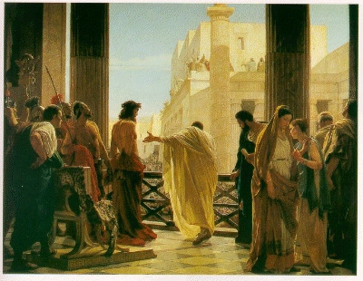
Bema is Used of Jesus Before Pilate
Notes:
22

Slide 23
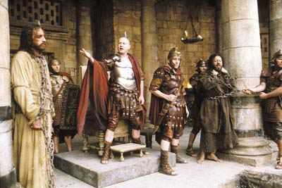
Jesus Before Pilate
Notes:
23

Slide 24
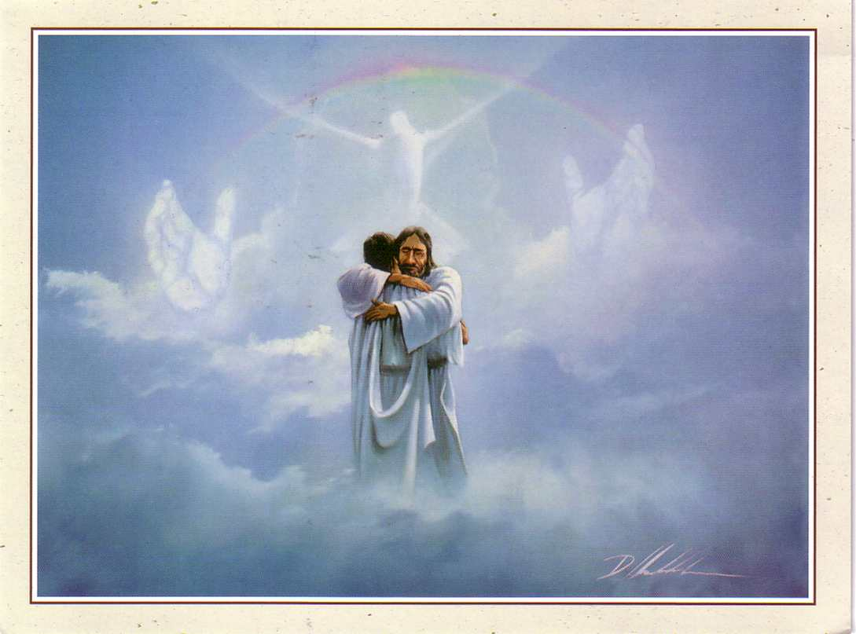
The Bema is a Reward Seat
76

Slide 25
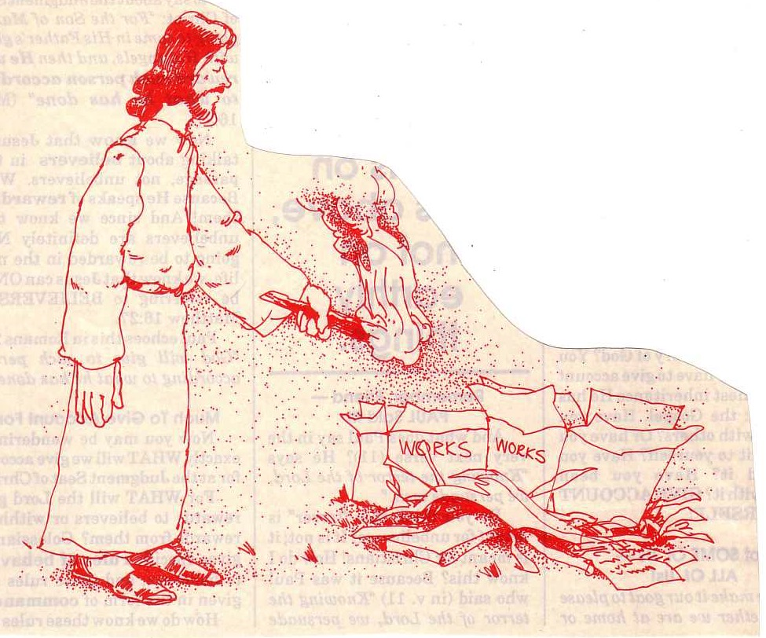
"… the fire will test the quality of each man's work"
(1 Cor. 3:13)
76
Notes:
25

Slide 26

Some love running.

Slide 27
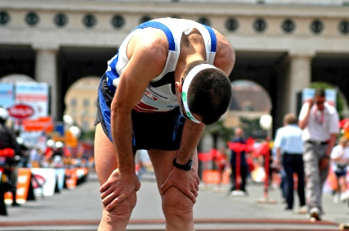
Some quit.

Slide 28

The Christian life is a race

Slide 29

Some are running well but…

Slide 30
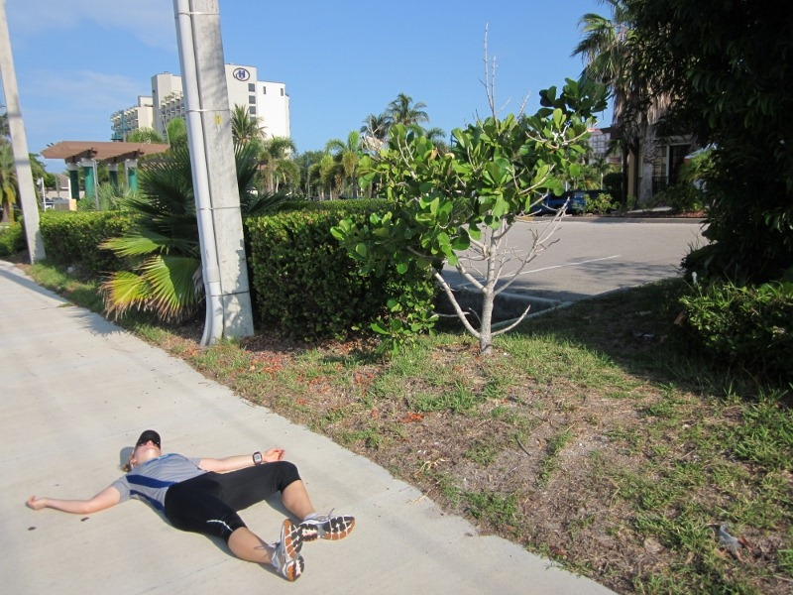
Some quit the Christian race

Slide 31

How long will you run with Christ?

Slide 32

"They used to be here."
• Divorce
• College doubts
• Living together
• Living apart

Slide 33
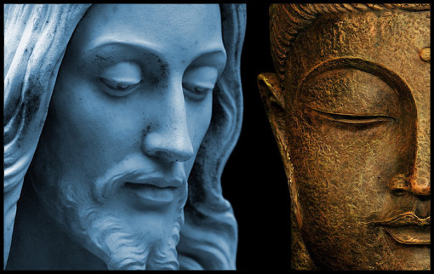
Singaporean Returns
Notes:
The last major study of new believers in Singapore in the 1980s shows that one third of Buddhists who become Christians then return to Buddhism (Keith Hinton, Growing Churches, Singapore-Style).

Slide 34
What about you?
NTS 266t
Atheist?
Ancestor Worship?
Buddhist?
Free thinker?
Hindu?
Muslim?
Taoism?
Christian?
Nominal Christian?
What was your previous religion?
What tempts you to go back?
Notes:
The Hebrew temptation to return to Judaism is real today for Christians as 30% of Singapore converts return to Buddhism!

Slide 35

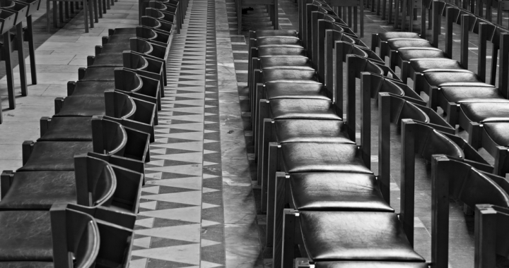
"They used to be here."

Slide 36

Keep running

Slide 37

Why keep running?

Slide 38

Why keep running?

Slide 39
Will each genuine Christian persevere in faithfulness at death?
NTS
274i
Esch
78p
Yes
No
Reformed
Partakers
Arminian
Apostasy
Cannot Happen
Apostasy Leads to Loss of Rewards
Apostasy Leads to Loss of Salvation
Eternal Security but No Assurance
Eternal Security
and Assurance
No Eternal Security and No Assurance

Slide 40

An Impossibility (Heb. 6:4-6 NLT)
For it is impossible to bring back to repentance those who were once enlightened—those who have experienced the good things of heaven and shared in the Holy Spirit, ⁵who have tasted the goodness of the word of God and the power of the age to come— ⁶and who then turn away from God. It is impossible to bring such people back to repentance; by rejecting the Son of God, they themselves are nailing him to the cross once again and holding him up to public shame.

Slide 41
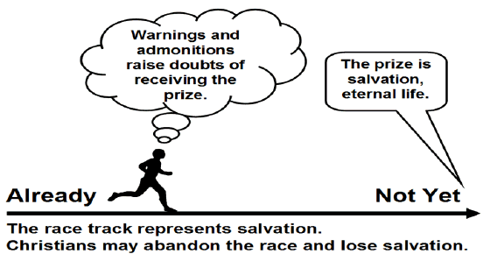
The Arminian View of Hebrews 6:4-8
Bob Deffinbaugh, "13. Dairy Queen or Steak and Ale (Hebrews 6:4-8)"
https://bible.org/seriespage/13-dairy-queen-or-steak-and-ale-hebrews-64-8
Warnings and admonitions raise doubts of receiving the prize.
The prize is salvation,
eternal life.
Already
Not Yet
The race track represents salvation.
Christians may abandon the race and lose salvation.
Notes:
The Arminian View
Summary: A Christian may turn away from his faith and thus may lose his salvation.
Main elements:
Those warned are genuine believers.
Future salvation is not assured (no eternal security).
The warning concerns eternal judgment (hell).
Positive aspects:
It appears to take the description of those warned at face value.
It appears to take the warnings literally.
Concerns:
It contradicts the doctrine of eternal security and raises doubt as to the certainty of one attaining salvation.
Bob Deffinbaugh, "13. Dairy Queen or Steak and Ale (Hebrews 6:4-8)"
https://bible.org/seriespage/13-dairy-queen-or-steak-and-ale-hebrews-64-8

Slide 42
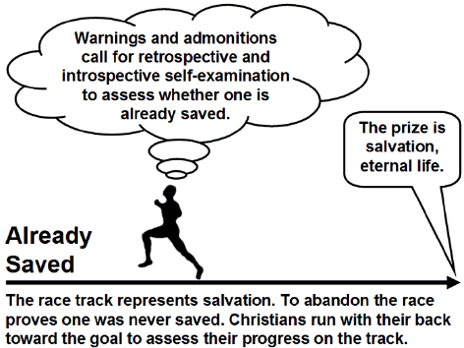
The Reformed (Calvinist) View
Warnings and admonitions call for retrospective and introspective self-examination to assess whether one is already saved.
The prize is salvation,
eternal life.
Already
Saved
The race represents salvation. To abandon the race proves one was never saved. Christians run with their back toward the goal to assess their progress on the track.
Notes:
The Calvinistic View
Summary: If an apparent Christian apostatizes (falls away by denying the faith), then we know he was never really saved in the first place.
Main elements:
Those warned and disciplined are not true believers.
Only an unbeliever can apostatize or fall away from the faith.
The warning of eternal judgment is for unbelievers.
Positive aspects:
It is consistent with the doctrine of eternal security.
It means that a Christian can never lose his faith.
It takes the warning of judgment seriously (for unbelievers).
Difficulties:
Can those described in verses 4-5 really be unsaved?
The emphasis falls on unbelievers, rather than believers (to whom the author appears to have
consistently been speaking up to this point).
Does this view undermine the confidence and assurance of believers in their confession? Will true believers always be doubtful of their salvation?
Bob Deffinbaugh, "13. Dairy Queen or Steak and Ale (Hebrews 6:4-8)"
https://bible.org/seriespage/13-dairy-queen-or-steak-and-ale-hebrews-64-8

Slide 43
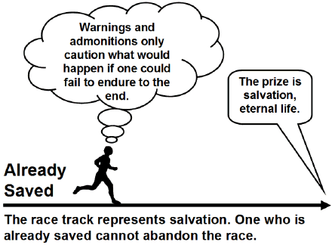
The Hypothetical View
Warnings and admonitions only caution what would happen if one could fail to endure to the end.
The prize is salvation,
eternal life.
Already
Saved
The race represents salvation. One who is already saved cannot abandon the race.
Notes:
The Hypothetical View
Summary: If a believer could apostatize, he would be eternally doomed (which will never happen), and thus there is no reason to continue to dwell on the ABC’s of the faith. This is the reason for moving from milk to meat.
Main elements:
It addresses believers hypothetically.
An apostate cannot be restored to salvation.
One should press on toward maturity.
Positive aspects:
It is consistent with the doctrine of eternal security.
It seeks to urge people on to maturity.
Difficulties:
It is only a theoretical view.
It doesn’t mean what the text appears to say.
It undermines the warnings.
It is an inferior motivation for growth.
Bob Deffinbaugh, "13. Dairy Queen or Steak and Ale (Hebrews 6:4-8)"
https://bible.org/seriespage/13-dairy-queen-or-steak-and-ale-hebrews-64-8

Slide 44
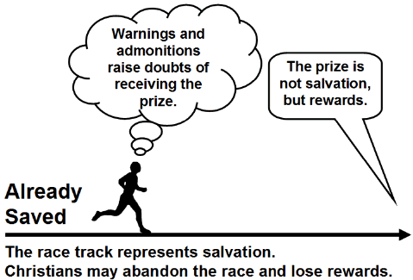
The Loss of Rewards View
Warnings and admonitions raise doubts of receiving the prize.
The prize is not salvation,
but rewards.
Already
Saved
The race represents salvation.
Christians may abandon the race and lose rewards.
Notes:
The Loss of Rewards View
Summary: A Christian may fall away and thus lose future rewards, as well as encounter severe discipline in this life.
Main elements:
Those warned are viewed as genuine Christians.
Future salvation is assured for every true believer.
The warnings concern future rewards and earthly discipline.
Positive aspects:
The warnings apply to Christians (just as the exhortations do).
The warnings are taken seriously, as a very real possibility.
This view undergirds assurance and confidence in one’s confession.
Difficulties:
Is "earthly discipline" as severe as the description of the judgment on the one who falls away?
Is "earthly discipline" severe enough to match the description of judgment?
Bob Deffinbaugh, "13. Dairy Queen or Steak and Ale (Hebrews 6:4-8)"
https://bible.org/seriespage/13-dairy-queen-or-steak-and-ale-hebrews-64-8

Slide 45
The Loss of Life View
(held by Dr. Rick Griffith)
Warnings and admonitions exhort to press on with Christ or they may die physically.
The prize is not salvation, but inheritance in the kingdom.
Already
Saved
The race represents salvation.
Christians may abandon the race and lose their life.
Notes:
The Loss of Life View (This is my view as I do not find the other four views satisfactory)
Summary: A Christian may fall away and thus lose future rewards, as well as encounter severe discipline in this life TO THE POINT OF GOD TAKING THEIR LIFE.
Main elements:
Those warned are viewed as genuine Christians.
Future salvation is assured for every true believer.
The warnings concern future rewards and earthly discipline.
Positive aspects:
The warnings apply to Christians (just as the exhortations do).
The warnings are taken seriously, as a very real possibility.
This view undergirds assurance and confidence in one’s confession.
This takes the fire of Hebrews 10:27 in its normal sense of Jerusalem fires.
Difficulties:
This view seems to lack the deficiencies of the other views.

Slide 46

Hebrews
H

Slide 47
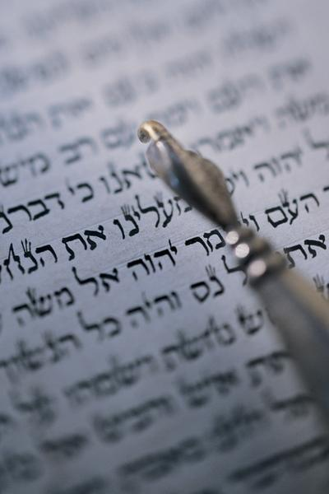
"Should I go back?"
"So we must listen very carefully to the truth we have heard, or we may drift away from it" (2:1 NLT).

Slide 48
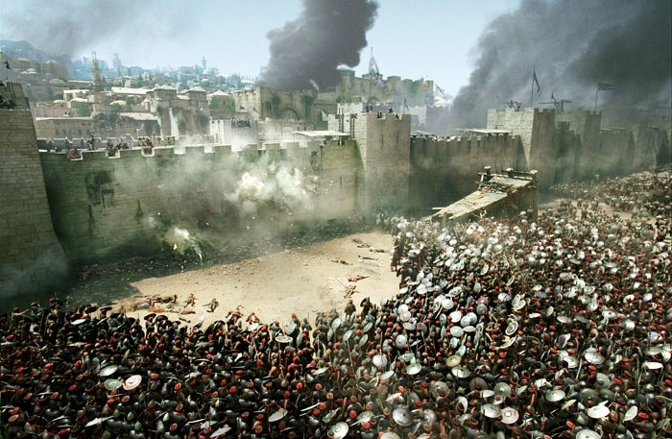
Antonia Fortress Leveled

Slide 49

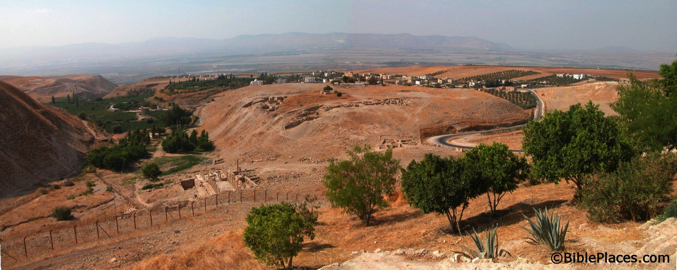
What happened to the Christians in Jerusalem?
A revelation told them to find protection in Pella.
Pella
Jerusalem
Notes:
Todd Bolen: "Pella/Pehel is not mentioned explicitly in the Bible but it was prominent in biblical times. In the days of the judges, it led a rebellion against Egypt which was crushed by Pharaoh Seti I. In NT days, Pella was the site where Christians sought refuge during the Jewish Revolt against the Romans in 66-70 A.D. Eusebius records that the Jewish believers fled here in obedience to a revelation, which some correlate with Jesus' words in Matthew 24:16. This photo views the tell from the east. Several Byzantine churches have been excavated as well as a building believed to be a Late Bronze temple. The Jordan Rift and the mountains of Israel are visible in the background."

Slide 50

Press On!
A Study of Hebrews

Slide 51

5 Warnings in Hebrews
258
Warning of discipline (2:1-4)
Warning of disinheritance (3:7-19)
Warning of death (6:4-8)
Warning of death (10:26-31)
Warning of unconcern (12:14-29)
Notes:
We have already seen three other warnings in this book…

Slide 52
The Fire
"Dear friends, if we deliberately continue sinning after we have received knowledge of the truth, there is no longer any sacrifice that will cover these sins. ²⁷ There is only the terrible expectation of God's judgment and the raging fire that will consume his enemies" (Hebrews 10:26-27 NLT).
Hell fire?
No, Jerusalem fire!
Notes:
What would be God’s judgment on these readers if they turned away?
• Verses 26-27 define God's judgment as “the raging fire that will consume his enemies." The readers would not be forgiven and would be judged with unbelievers. But when and how?
• Most commentaries claim that this means the readers would go to hell.
But is this hell fire? If so, that would mean these Christians would then go to hell! This is against all that the NT teaches about believers having eternal life.
• No, it refers to Jerusalem fire! Their salvation was secure—but their apostasy would lead to being killed along with the unbelieving Jews who stayed in Jerusalem to protect them temple! The letter consistently calls them believers, but they would bear a punishment of unbelievers by identifying with them. Yet the fire of 10:27 is not hell fire but Jerusalem fire. It was not eternal fire but temporal fire that would take their lives along with the godless who gave their lives in AD 70 while trying to preserve a temple system that was already a generation obsolete.
__________
Common-465
BE-58-Hebrews Be Uncompromising-80
BS-09-Read Paragraphs-33
ES-10-Other Events at the Rapture-52
HS-03-Spirit Ministries to Believer-19
NP-19-Hebrews Be Uncompromising-80
NS-19-Hebrews-421, 458
OS-36-Zephaniah-38
SA-09-Perseverance-42, 66
SA-14-Eternal Security-66
SA-15-Inheritance-169

Slide 53
Views on the Warning Passages
266c
What group of Jews is being addressed ?
False Believer | Former Believer | Carnal Believer
People who are not really believers | Christians who sin by not seeing Christ's superiority | Christians who sin by not seeing Christ's superiority

Slide 54
Views on the Warning Passages
266c
What is the nature of their punishment ?
False Believer | Former Believer | Carnal Believer
Never had Salvation | Loss of Salvation | Loss of Reward

Slide 55
Views on the Warning Passages
266c
What is the result ?
False Believer | Former Believer | Carnal Believer
Hell | Hell | Divine Discipline

Slide 56
Views on the Warning Passages
266c
Which theological perspective
holds to this view ?
False Believer | Former Believer | Carnal Believer
Reformed | Arminian | Partakers

Slide 57
Views on the Warning Passages
266c
Strengths
False Believer | Former Believer | Carnal Believer
Signifying Hell (sees the judgment as serious) | Signifying Hell (sees the judgment as serious) | Loss of rewards as a judgment (a concept often taught in the NT)

Slide 58
Views on the Warning Passages
266c
Weaknesses
False Believer | Former Believer | Carnal Believer
Consistently speaks of the readers as genuine Christians | Temporal security goes against NT doctrine of justification by grace | 10:27 refers to judging persons, not deeds

Slide 59
The Problem with Labels
266c
Must we be one or the other…?
Reformed?
…or…
Arminian?
Many do Fall Away
Loss of Salvation
Weaknesses
Eternal Security
Reality of Apostasy
Strengths
Partakers View Has Both Strengths & Neither Weakness

Slide 60
Implications of the Rapture
78o

Slide 61
We will join him in the clouds

Slide 62
Black

Slide 63
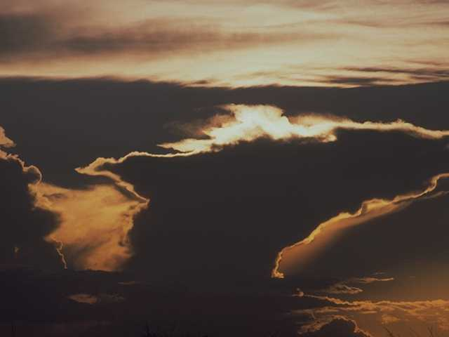
The sky shall unfold…

Slide 64

…preparing His entrance

Slide 65

The stars shall applaud Him with thunders of praise

Slide 66
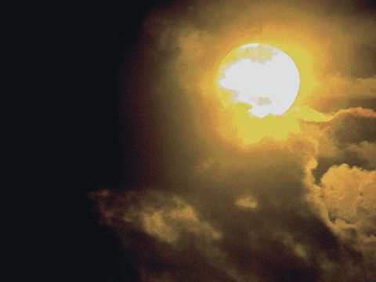
The sweet light of His eyes shall enhance those awaiting

Slide 67
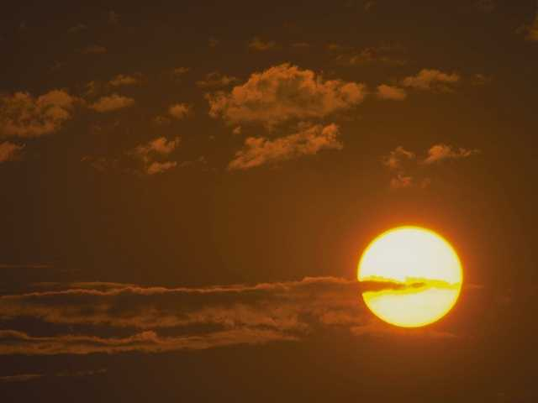
And we shall behold Him then face to face

Slide 68
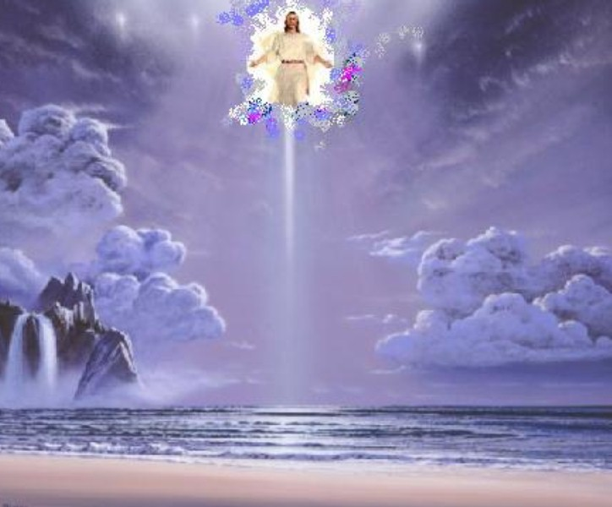
We shall behold Him
We shall behold Him

Slide 69
…face to face in all of His glory

Slide 70

We shall behold Him
We shall behold Him

Slide 71
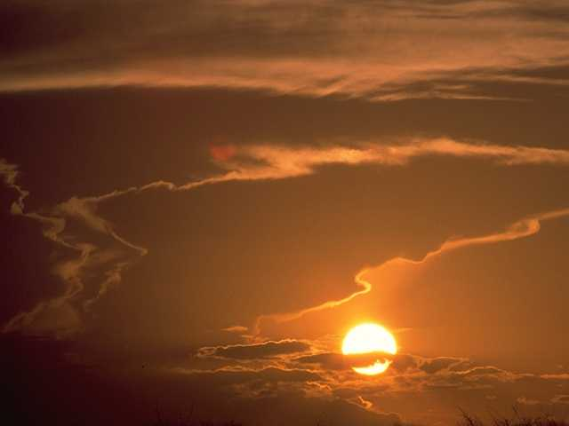
…face to face, our Savior and Lord

Slide 72
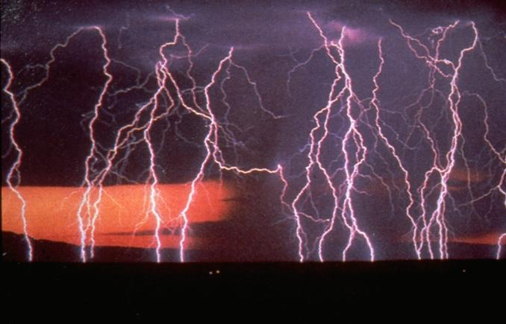
The angel shall sound the shout of His coming

Slide 73
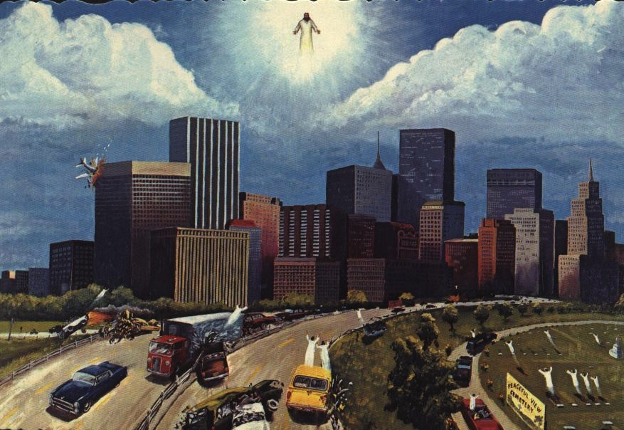
The sleeping shall rise from their slumbering place

Slide 74
And those who remain shall be changed in a moment

Slide 75
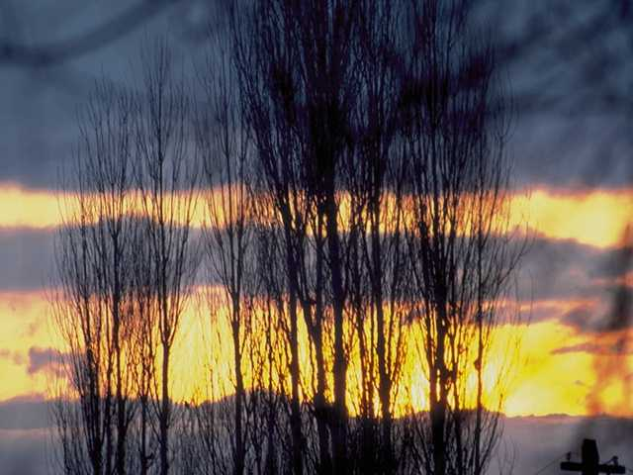
And we shall behold Him then face to face

Slide 76
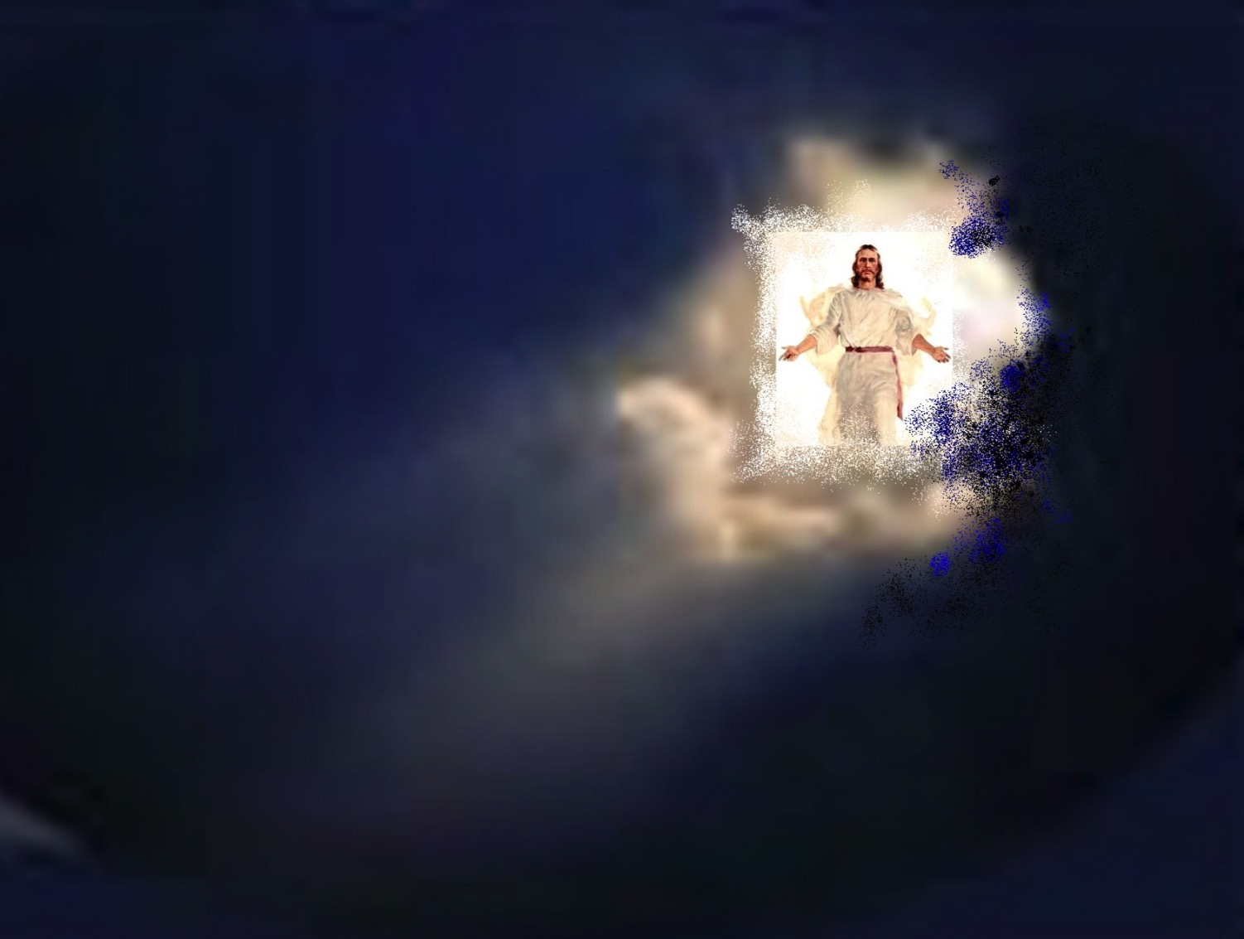
We shall behold Him
We shall behold Him

Slide 77
…face to face in all of His glory

Slide 78
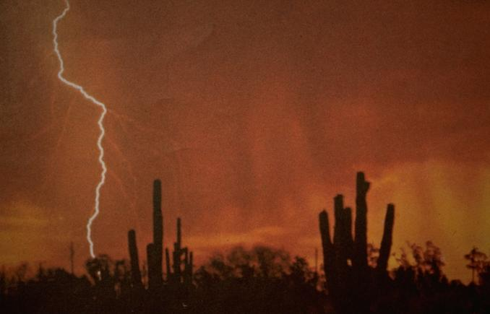
We shall behold Him
We shall behold Him

Slide 79
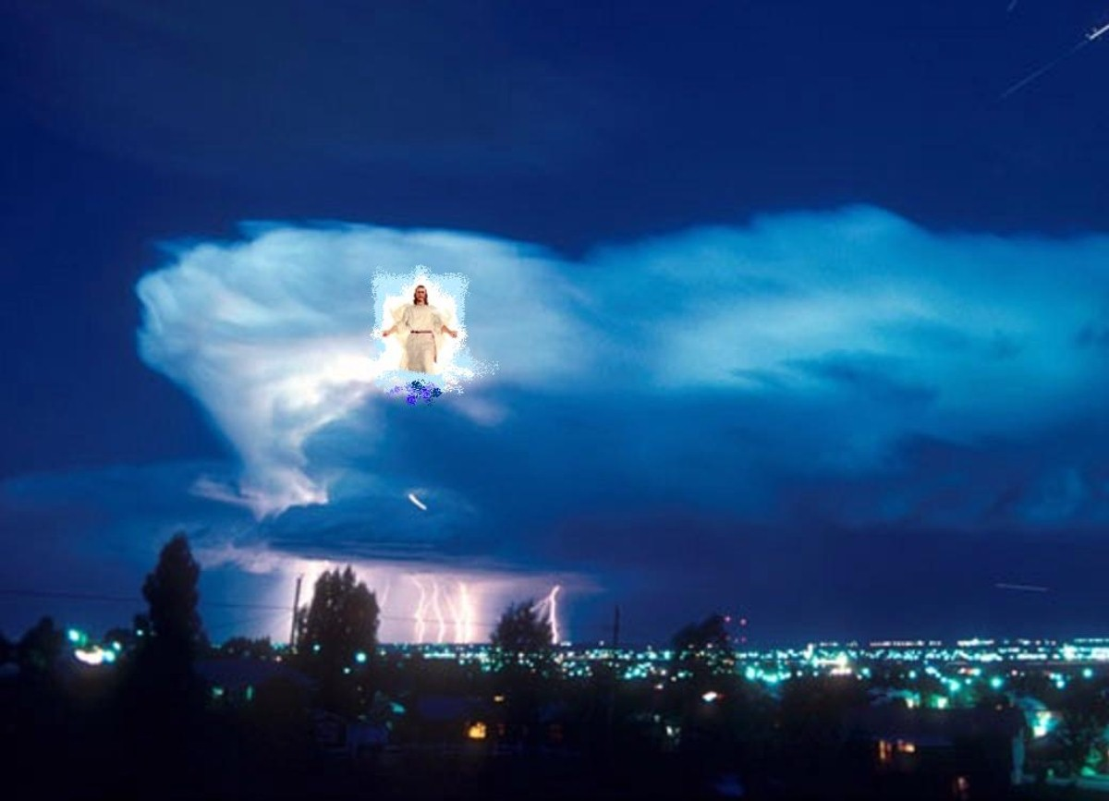
…face to face, our Savior and Lord

Slide 80
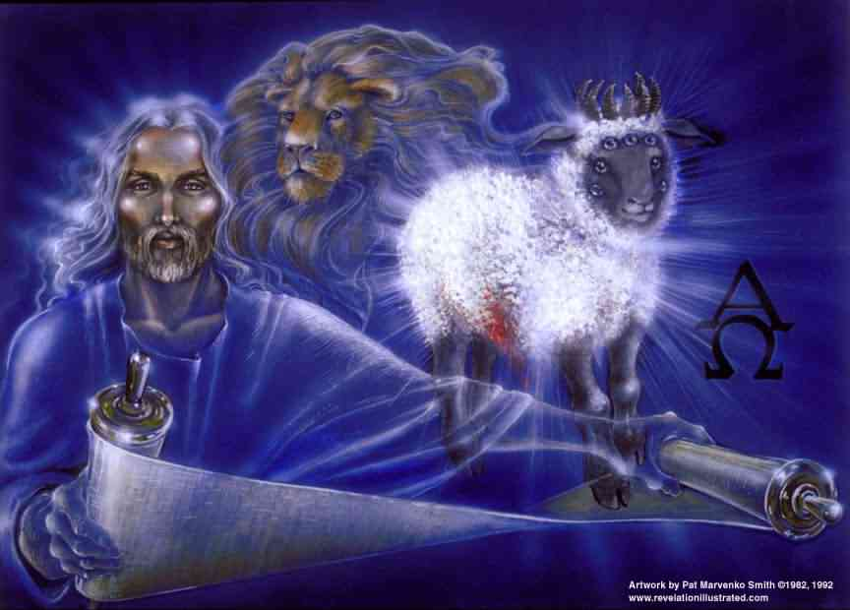
We shall behold Him, our Savior and Lord

Slide 81


Future (Eschatology) link at BibleStudyDownloads.org
Get this presentation for free!
Notes:
NT Survey (ns)

Slide 82
Black

